Slide 1
Heapsort
By
Tanvir Ahammad
Lecturer,
Dept. of CSE, JnU.

Slide 2
Introduction
Like merge sort, but unlike insertion sort, heapsort's running time is O(n lg n);
Like insertion sort, but unlike merge sort, heapsort sorts in place:
only a constant number of array elements are stored outside the input array at any time
Does not use two temporary array
Heapsort combines the better attributes of the two sorting algorithms;

Slide 3
Cont.
the term "heap" was originally coined in the context of heapsort, but it has since come to refer to "garbage-collected storage," such as the programming language Lisp provides
Our heap data structure is not garbage-collected storage
The (binary) heap data structure is an array object that we can view as a nearly complete binary tree

Slide 4
Concept of heapsort
Goal:
sort an array using heap representation
Idea
Build a max-heap (min-heap) from the array
Swap the root (largest element) with the last element in the array
Discard this last node by decreasing the heap size
Call MAX-HEAPYFI on the new node
Repeat this process until one node remains

Slide 5

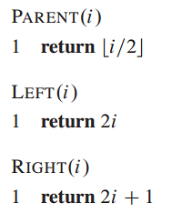
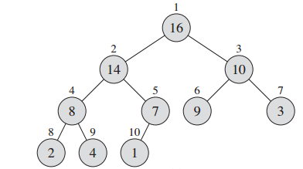
Preliminaries of heapsort: max-heap/min-heap
QUIZ: Is the array with values A={23; 17; 14; 6; 13; 10; 1; 5; 7; 12} a max-heap?

Slide 6
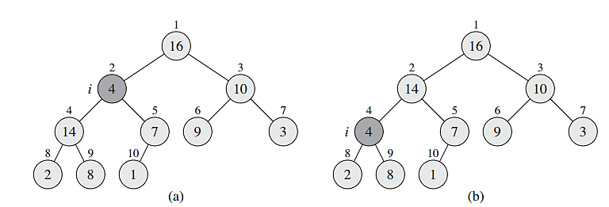
Preliminaries of heapsort: max-heapify
The action of HEAPIFY(A, 2), where heap-size[A] = 10. (a) The initial configuration of the heap, with A[2] at node i = 2 violating the heap property since it is not larger than both children.

Slide 7
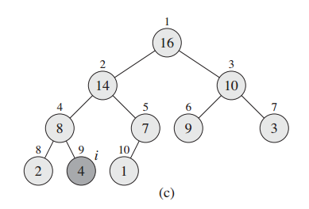
Preliminaries of heapsort: max-heapify
(c) node 4 is fixed up, and the recursive call HEAPIFY(A, 9) yields no further change to the data structure.

Slide 8
Exercise
Illustrate the operation of HEAPIFY (A, 3) on the array A = {27, 17, 3, 16, 13, 10, 1, 5, 7, 12, 4, 8, 9, 0}.

Slide 9
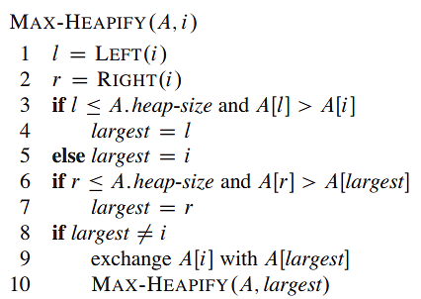
Max-heapify procedure

Slide 10

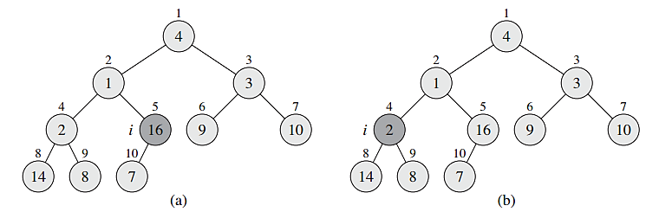
Preliminaries of heapsort: building max-heap

Slide 11
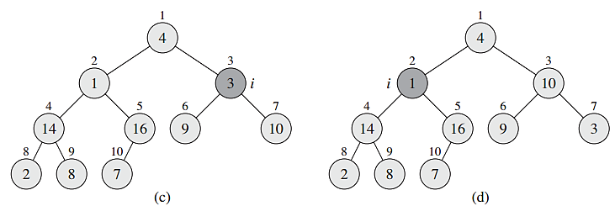
Preliminaries of heapsort: building max-heap

Slide 12
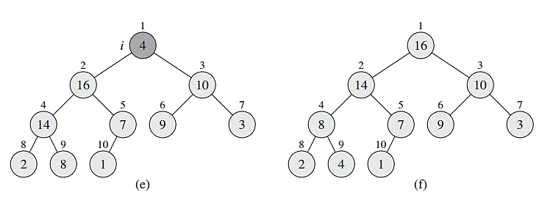
Preliminaries of heapsort: building max-heap

Slide 13
Exercise
Illustrate the operation of BUILD-HEAP on the array A = {5, 3, 17, 10, 84, 19, 6, 22, 9}.

Slide 14
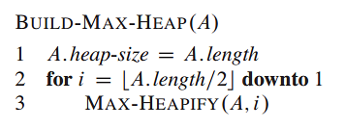
Build max-heap procedure
Why do we want the loop index i in line 2 of BUILD-HEAP to decrease from length[A]/2 to 1 rather than increase from 1 to length[A]/2?

Slide 15
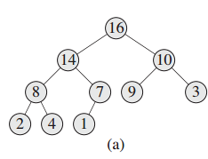
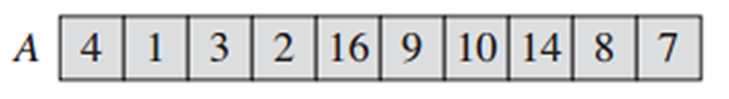
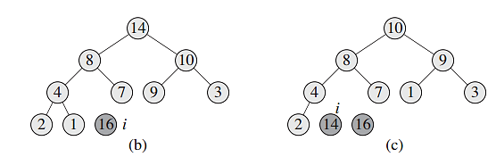
Heapsort algorithm

Slide 16
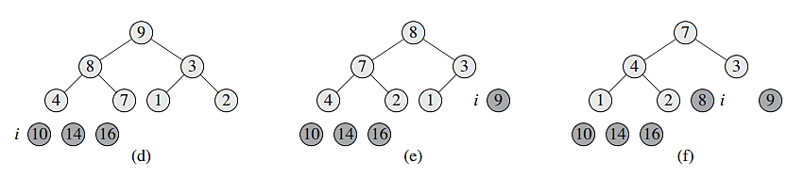
Heapsort algorithm

Slide 17
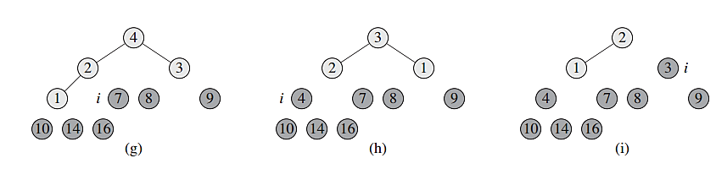
Heapsort algorithm

Slide 18
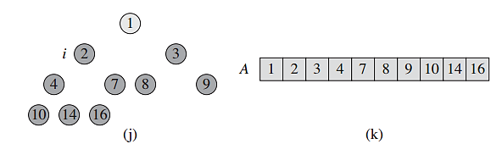
Heapsort algorithm

Slide 19
Exercise
Illustrate the operation of HEAPSORT on the array A = {5, 13, 2, 25, 7, 17, 20, 8, 4}.

Slide 20
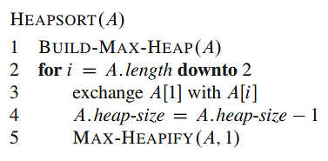
Heapsort algorithm

Slide 21
max-priority queue
To be taught later

